Slide 1

Classification Model with 93% Accuracy – Telco Customer Churn Analysis
12 Jan 2024
by Ahmad zaki bin ramli

Slide 2
Table of Content
Self Introduction
Course Timeline
Technology Stack
Project Overview, Problem Statement & Objective
Exploratory Data Analysis
- Education, Work experience & About me
- The period spanning from month 1 to month 6
- Language, tools and environment
- This project aims to address industry problems by achieving objectives through the defined step
- Data Inspection, Anamolies Detection (Distribution & Boxplot)
Feature Impotance (Random Forest)
Predictive Modeling
Solution
Project Timeline
- Encoding, Random Forest ML, Hyperparameter Tuning & Top of feature
- Encoding, Machine learning, Hyperparameter Tuning & Result
- Recommendations for reducing churn
- Milestones and key deliverables
Project Budget
- Estimated cost breakdown

Slide 3







Self Introduction
About me
Name: Zaki
Hometown: Ipoh, Perak.
Current Location: Living in Putrajaya for work purposes
Passion: Determined to explore new fields and continuously learn and improve.
Education
Degree: Bachelor’s in Economics
Graduate Year: End of 2022
Challenges: Completed degree during the COVID-19 pandemic, which made learning and exams difficult due to the shift to online platforms
Achievement: Despite challenges, remained focused on pursuing personal growth and career development.
Work experience
Position: Personal MYSTEP (Graduate Program) at the Ministry of Economic Affairs
Duration: Almost 2 Years
Responsibilities: Gained experience in management and government-related work, assisting in economic projects and initiatives.

Slide 4

Course Timeline
Month 1
Month 2
Month 3
Month 4
Self resilience mastery, Communication Mastery, career Launcpad Mastery
Introduction of Data Science
Set up Environment
Introduction to Language python and Others Libraries (Pandas)
Introduction to Numpy
Data Visualization with Seaborn
Web Scraping
Introduction Language SQL
Introduction Statistical Data Analysis
Introduction to Machine Learning
Supervised Learning
Unsupervised Learning
Introduction to Recommended System
Month 6
Month 5
Final Review
Introduction to Deep Learning & NLP
Capstone Project
Self Leadership

Slide 5







Technology Stack
Data Analysis Tools
Visualization Libraries
Machine Learning Frameworks

Slide 6
Project Overview
Problem Statement
Customer churn impacts the revenue and growth of telecommunications companies like Celcom.
Celcom needs to identify the key factors that affect customer churn, such as pricing, network quality, customer service, and service offerings.
This project aims to predict customer churn by analyzing data on Celcom's customers and their service usage patterns.
Identifying patterns and trends in the data will help Celcom improve its customer retention strategies, allowing them to take actions to prevent churn and retain valuable customers.
Customer churn directly affects the profit and growth of telecommunications companies like Celcom.
In a competitive market, companies such as Celcom, Maxis, Digi, and U Mobile face chall
Customers may leave due to factors such as pricing, service quality, customer support, or better offers from competitors.
It is important to identify the key factors influencing churn, such as network reliability, customer service satisfaction, and pricing structure.
Predicting the likelihood of churn helps companies like Celcom take effective preventive actions to retain customers.
Objective
Identify the factors influencing churn and patterns in the data.
Predict customer churn using machine learning model.
Help Celcom companies improve their customer retention strategies.

Slide 7
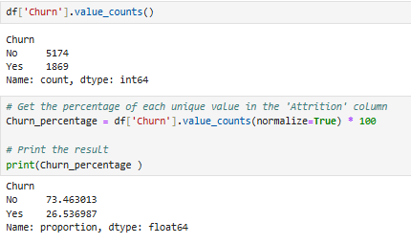
( 7043,21 )
Exploratory Data Analysis
(20)
(1)
X = FEATURE
Y = TARGET
CustomerID
Gender
SeniorCitizen
Churn
Partner
Tenure
Dependents
MultipleLines
InternetService
OnlineSecurity
OnlineBackup
DeviceProtection
Techsupport
StreamingTV
StreamingMovies
Contract
PaperlessBilling
PaymentMethod
PhoneService
MonthlyCharges
TotalCharges
Shown imbalance dataset (Churn)

Slide 8
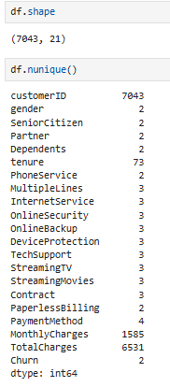
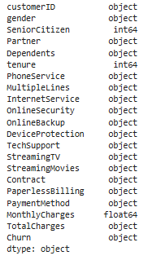
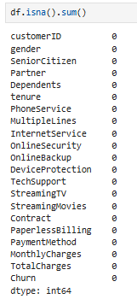
Inspection Datatypes, Missing Values
Don’t have any missing values
Exploratory Data Analysis
Don’t have any duplicated data
checking the following parts of the data for an initial review :
Datatypes
Duplicates data
Missing values
Need to change to numerical instead of object

Slide 9
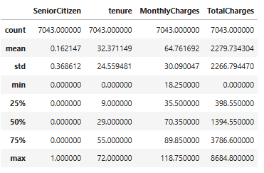
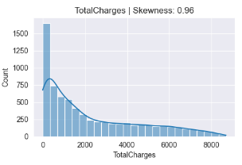
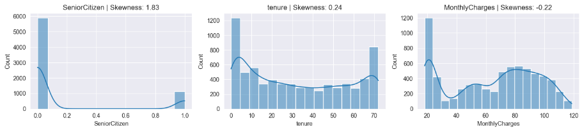
Anamolies Detection (Stats / Distribution)
Exploratory Data Analysis
Basic statistic
Total Charge looks suspicious at the first inspection

Slide 10
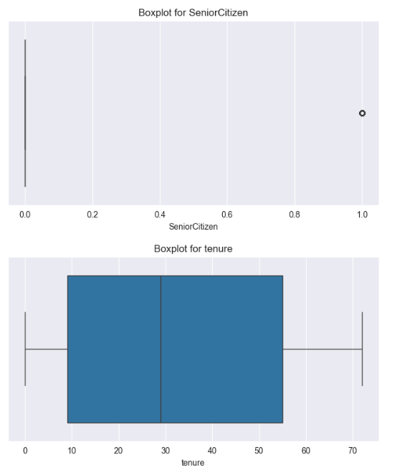
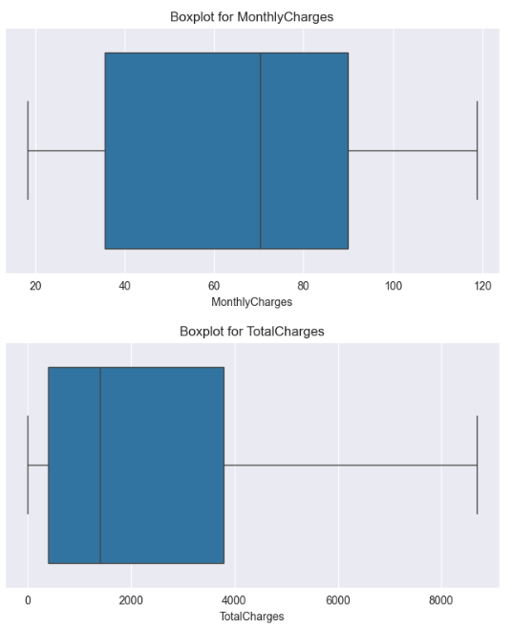
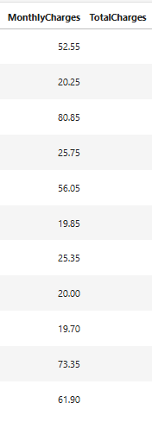
Anamolies Detection (Boxplot)
Exploratory Data Analysis
Explanation
Total Charge looks suspicious for the first inspection.
Total Charge = 0 meaning they are a new customer and its really make sense and this is not the outliers
Tenure & MonthlyCharges looks normal

Slide 11
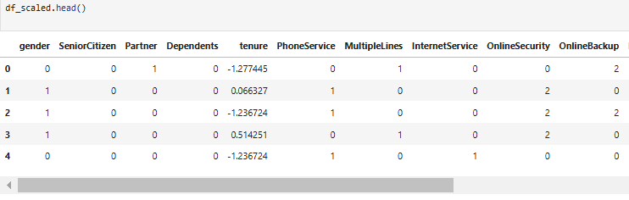
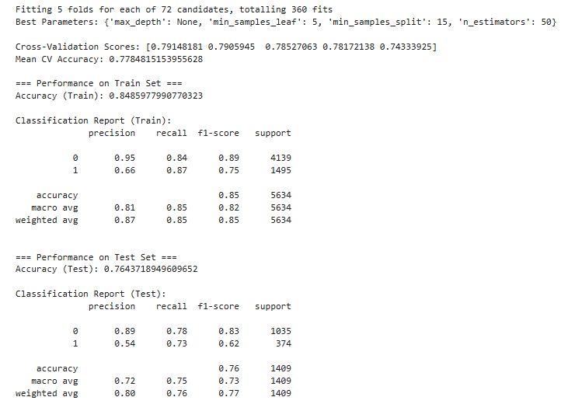
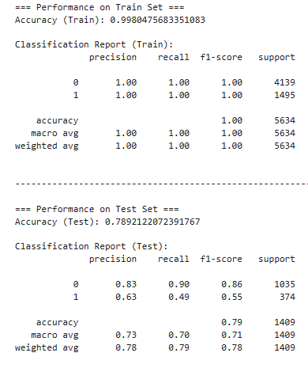
Feature Importance
Using Label Encoding
Scaling (Standardscaler)
Data Transformation
Machine Learning ( Random Forest)
Model Balance
Model Overfitting
TRAIN
TEST
After Tuning
This model ready for feature importance

Slide 12
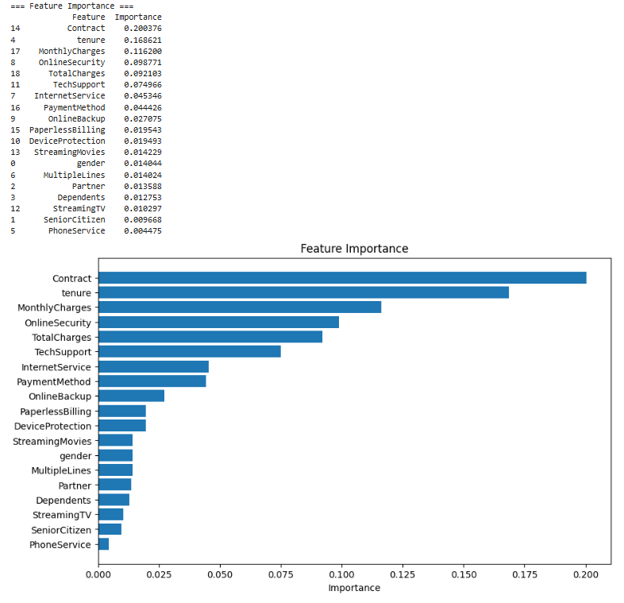
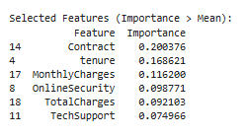
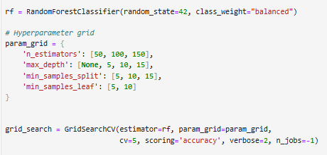
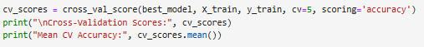
Feature Importance
Top Feature Impotance
Filtering process
Class Weight (Imbalance dataset)
Grid Search
Cross Validation
Hyperparameter Tuning

Slide 13
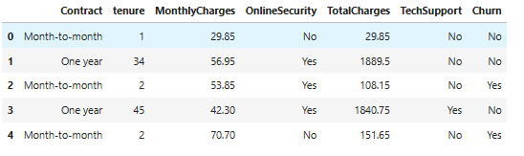
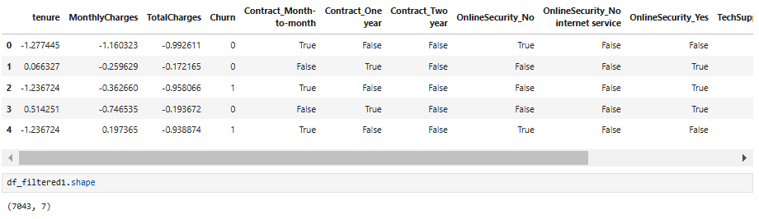
Predictive Modeling
Machine Learning
Data Transformation Using Top Feature
K- Nearest Neighbour
Random Forest
Run Model
Compare Model with Train & Test
Hyperparameter Tuning
Evalution
One Hot Encoding
Cross Validation
Grid Search
Oversampling (Imbalance dataset)

Slide 14
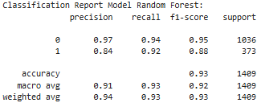
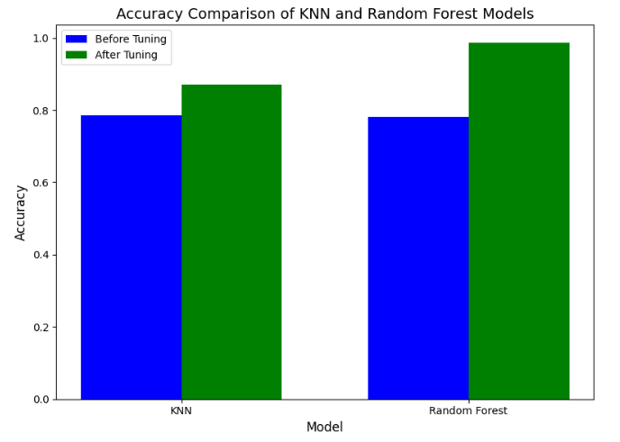
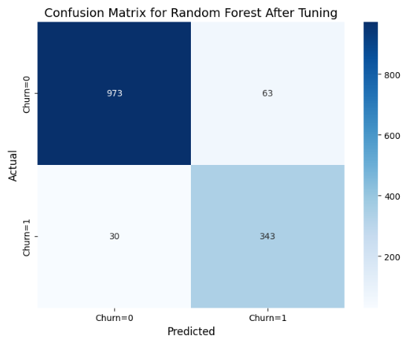
Predictive Modeling
Evaluation for Random Forest with 93% Accuracy
Result for each model

Slide 15
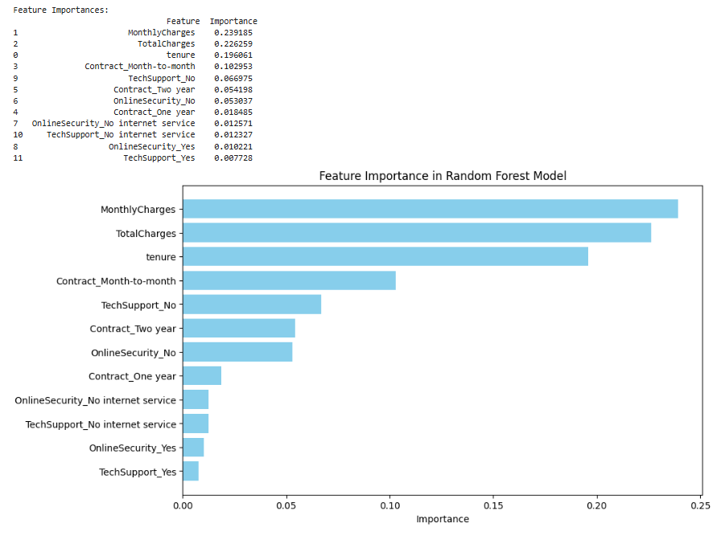
Predictive Modeling
Top Feature Impotance
Explanation
Very detail on feature importance compare with before because this dataset using One Hot Encoding.

Slide 16
Provide Solution
Recommendations for reducing churn
Focus on Customers with Month-to-Month Contracts:
Focus on High Total Charges Customers:
Addressing Issues with OnlineSecurity and TechSupport:
Utilizing ML Models for Churn Prediction:
Introduce Rewards Programme
Cash back
24/7 Technical support and online security
Early Warning Sytem for Retentation

Slide 17
Project Timeline
Week 1 & 2
Week 3 - 5
Week 6 - 9
Week 10
Project Planning & Setup (2 Weeks)
Data Collection & Preparation (3 Weeks)
Modelig and Analysis
(4 Weeks)
Final Review and Documentation (1 Weeks)

Slide 18
Project Budget
Bil | Cost Component | Cost (RM) | Explanation
1. | Salaries | 15,000 | Payment to team data experts for building a predictive model.
2. | Infrastructure | 12,000 | server (RM 10,000), and cloud storage(RM 2,000).
3. | Testing & Maintenance | 4,000 | Estimated cost for testing and updates (RM 1,000 per month for 4 months).
4. | Survey Costs | 4,000 | Includes survey design (RM 1,000), distribution (RM 500), incentives (RM 1,500), and data analysis.
Total Cost: RM 35,000

Slide 19
Conclusions
In the customer churn analysis for the companies, we successfully developed a classification model with 93% accuracy.
This model identifies customers at risk of churning and highlights key factors influencing their decisions, such as pricing, service quality, and customer support.
Implementing these strategies will help proactively engage with at-risk customers, reduce churn rates, and improve overall customer satisfaction.
Customer retention is vital for the growth and profitability of telecommunications companies like Celcom, etc.
By leveraging data-driven insights and implementing targeted strategies, can strengthen its customer relationships and gain a competitive advantage in the market.

Slide 20
Thank You For Your Time !

